Slide 1
AlphaGo
David Silver, et al. "Mastering the game of Go with deep neural networks and tree search." Nature 529.7587 (2016): 484-489.
Sungjoon Choi

Slide 2
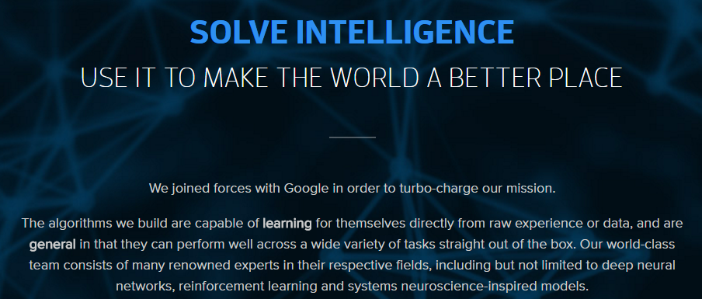
DeepMind
https://deepmind.com/

Slide 3
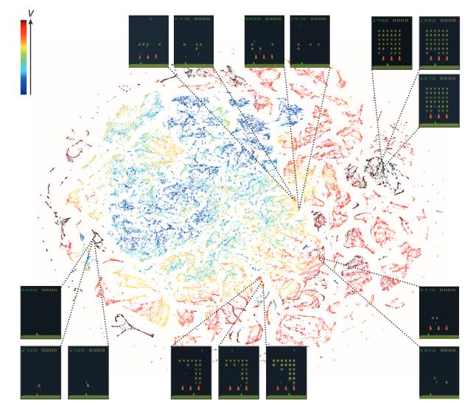
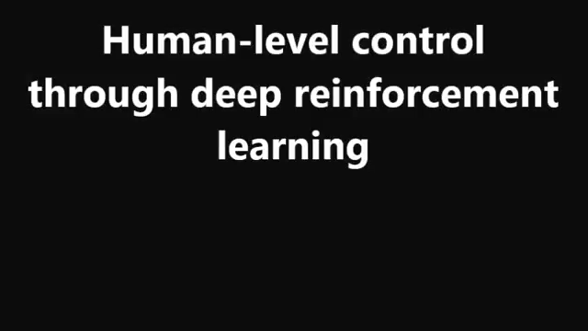
Prior Work of DeepMind
V. Mnih, K. Kavukcuoglu, D. Silver, A. A. Rusu, J. Veness, M. G. Bellemare, and S. Petersen (2015). Human-level control through deep reinforcement learning. Nature, 518(7540), 529-533.

Slide 4
Contents
Complexity of Go
Monte-Carlo Tree Search
Training Networks
Searching with policy and value networks
Experiments

Slide 5
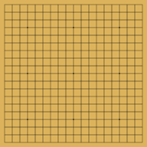
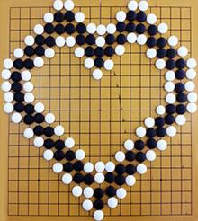
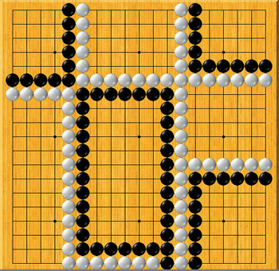
Complexity of Go

Slide 6
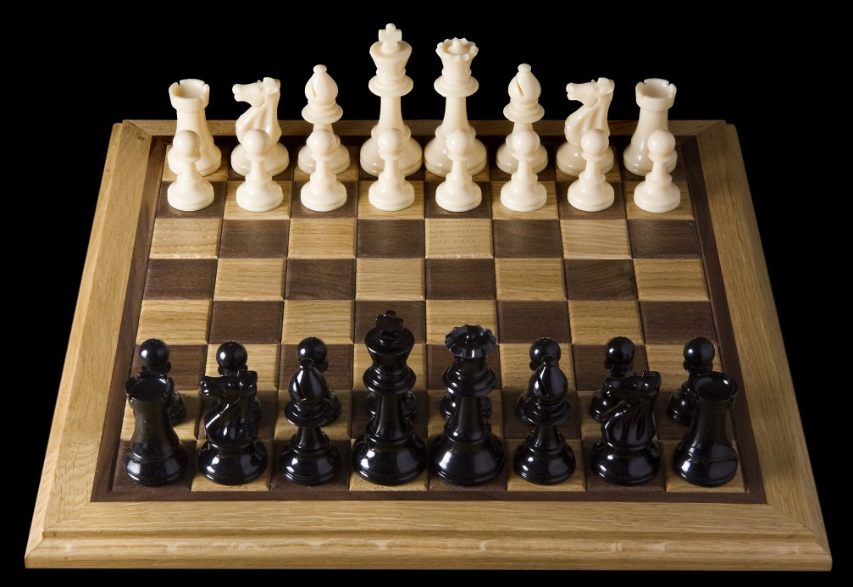
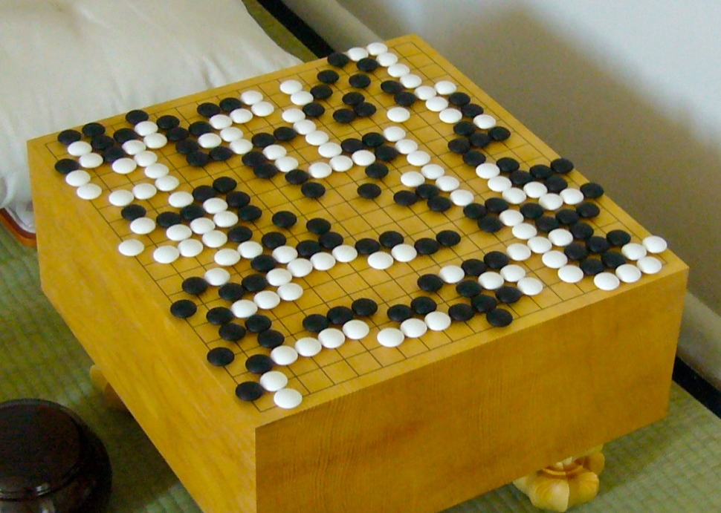
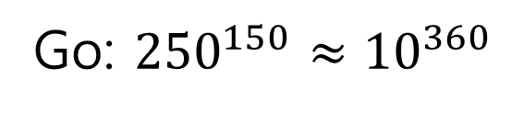
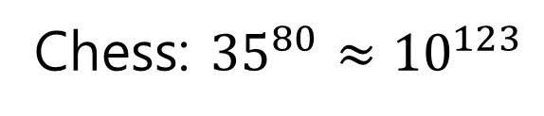
Complexity of Go
Chess: ${35}^{80}≈{10}^{123}$
Go: ${250}^{150}≈{10}^{360}$

Slide 7
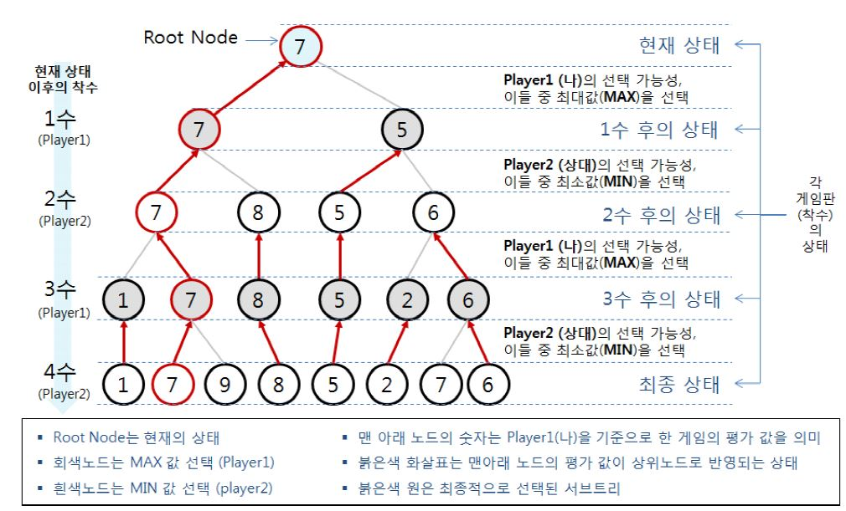
Monte-Carlo Tree Search

Slide 8
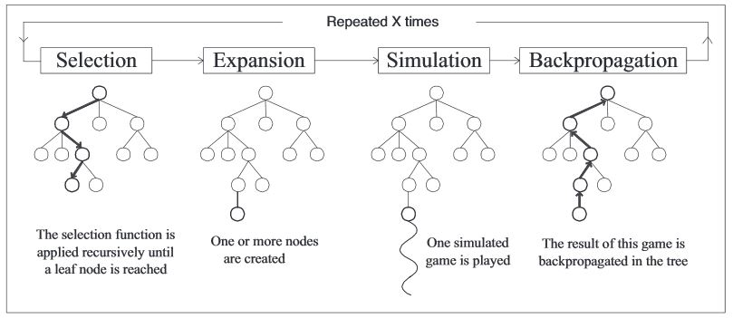
Monte-Carlo Tree Search
By some selection rule
By some expansion rule
By some simulation method

Slide 9
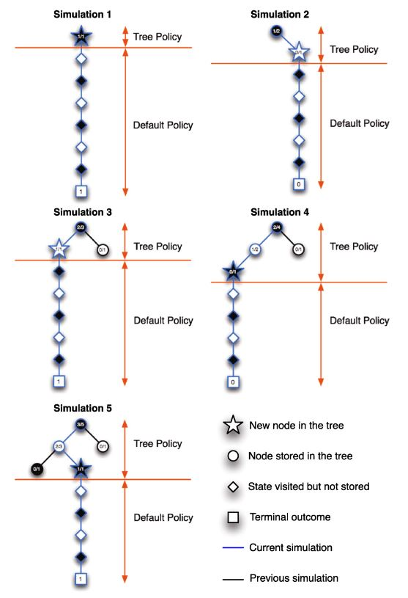
MCTS Example

Slide 10
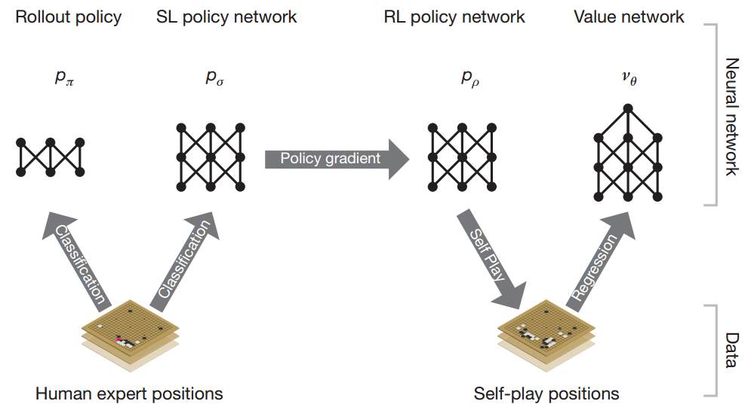
MCTS in AlphaGo

Slide 11
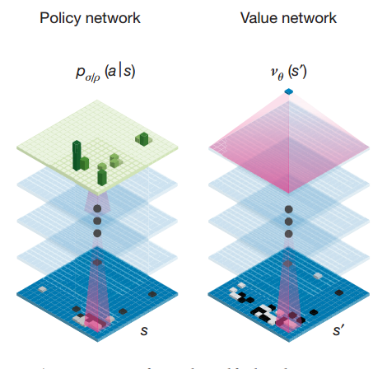
Policy Network and Value Network

Slide 12
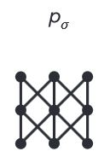
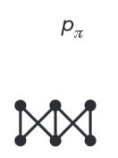
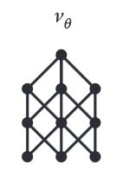
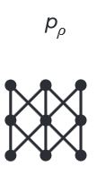
MCTS in AlphaGo
Rollout net
Value net
RL net
SL Policy Network

Slide 13
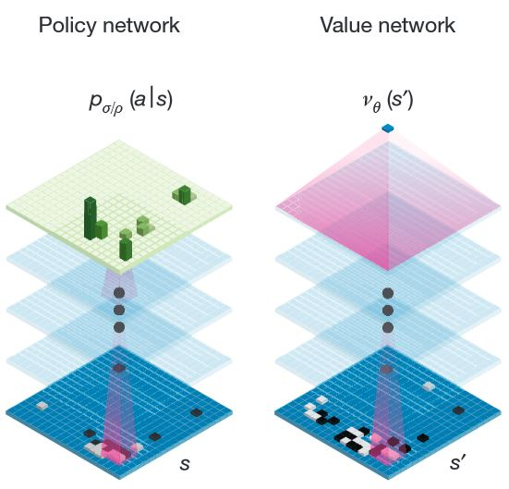
Training Networks
Rollout Policy Network (Rollout net)
Supervised Learning Policy Network (SL net)
Reinforcement Learning Policy Network (RL net)
Value Network (Value net)
SoftMax (13)
Tanh, Fc (15)
ReLU, Fc (14)
3*3, 192 filter
stride 1, ReLU
(2 ~ 12)
No Info (12,13)
3*3, 192 filter
stride 1, ReLU
(2~11)
5*5, 192 filter
stride 1, ReLU(1)
5*5, 192 filter
stride 1, ReLU(1)

Slide 14
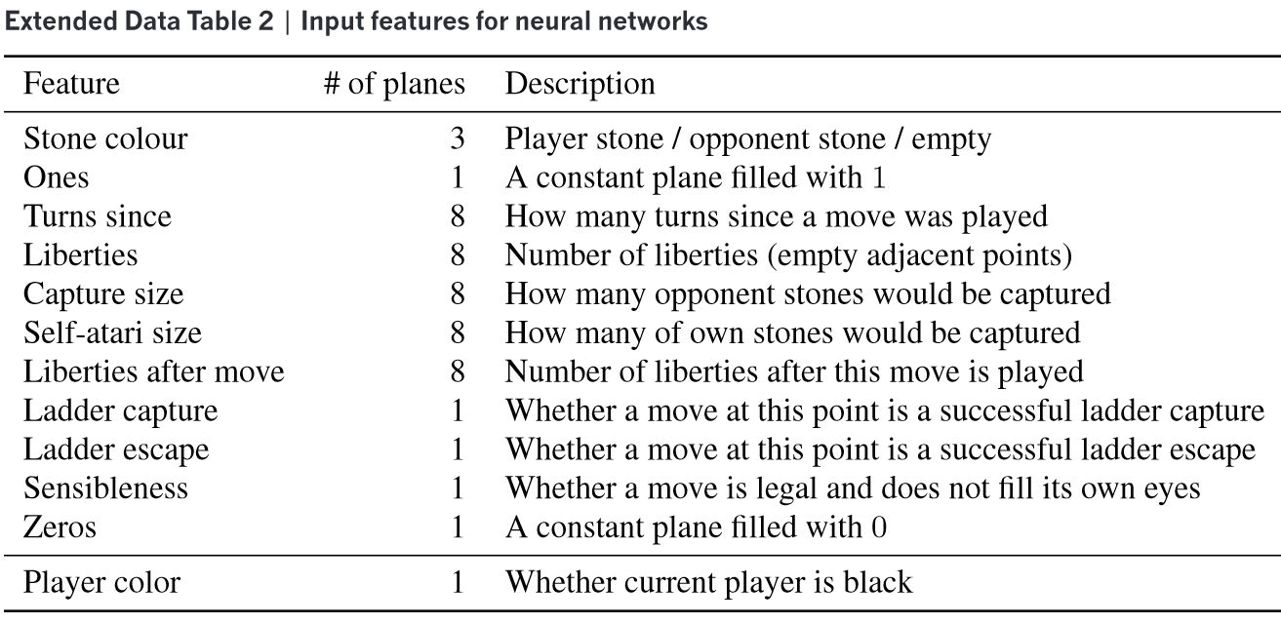
Training Networks

Slide 15
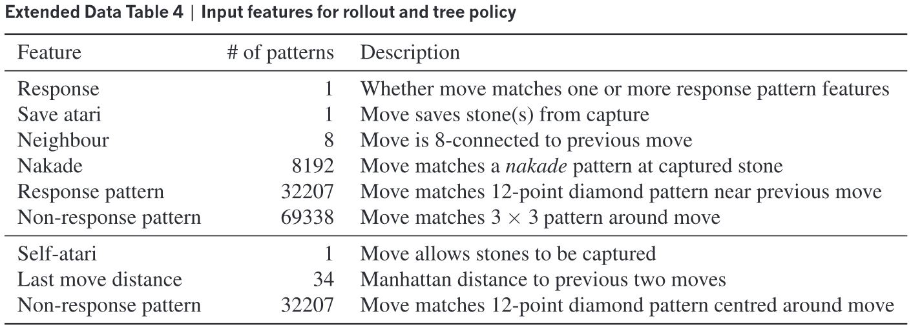
Training Networks

Slide 16
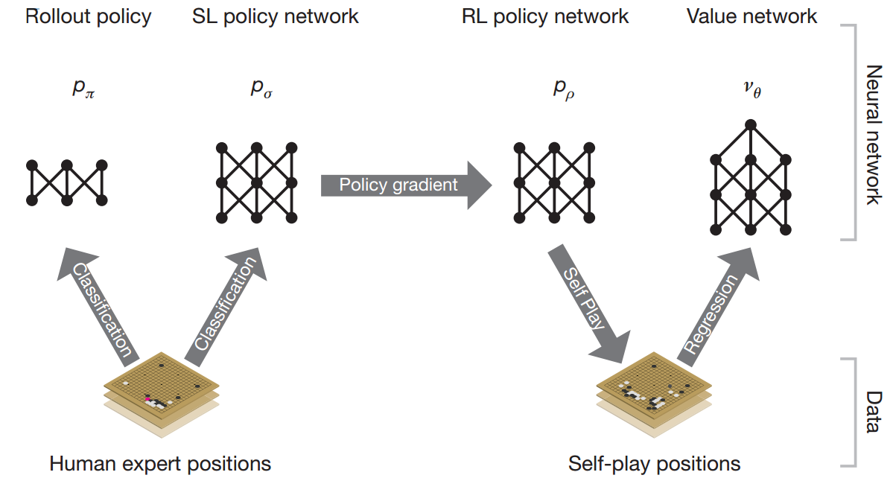
Training Networks

Slide 17
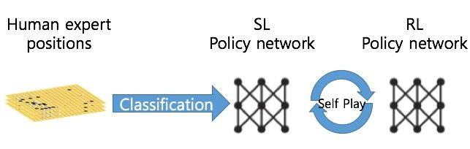
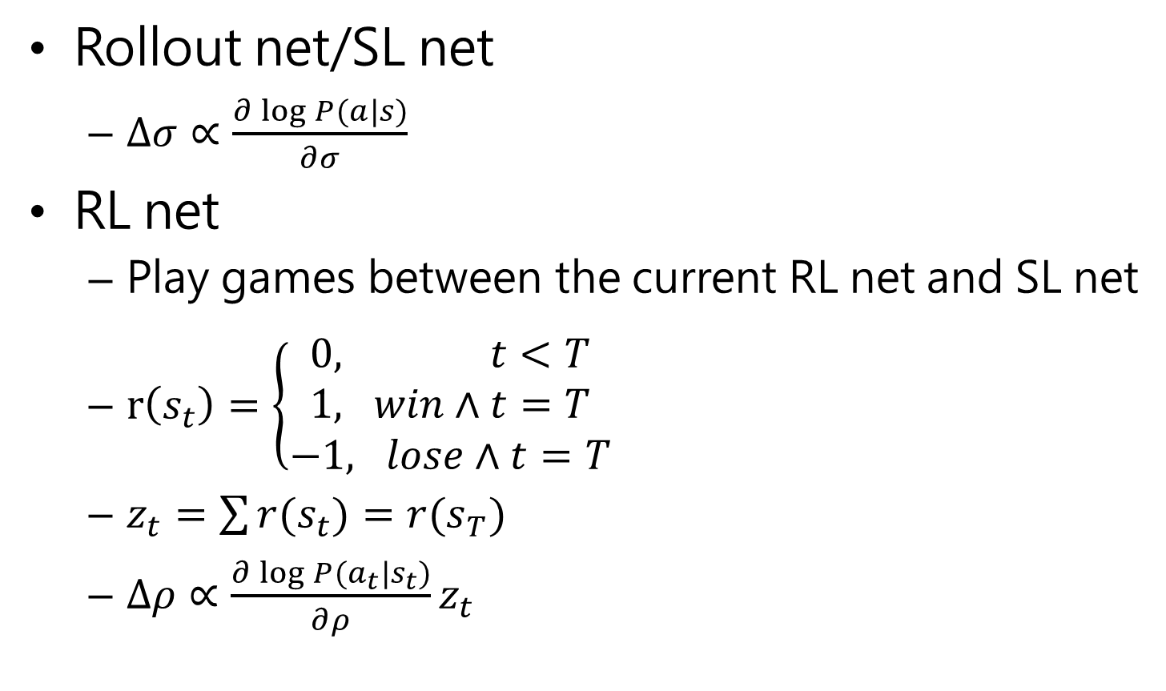
Training Policy Networks
Rollout net/SL net
$∆σ∝\frac{∂\log{P(a|s)}}{∂σ}$
RL net
Play games between the current RL net and SL net
$r\left(s_{t}\right)=\left\{\begin{aligned}0, t<T \\ 1, win∧t=T \\ &−1, lose∧t=T\end{aligned}\right.$
$z_{t}=\sum{r(s_{t})}=r(s_{T})$
$∆ρ∝\frac{∂\log{P(a_{t}|s_{t})}}{∂ρ}z_{t}$

Slide 18
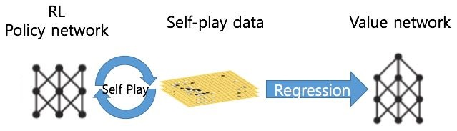
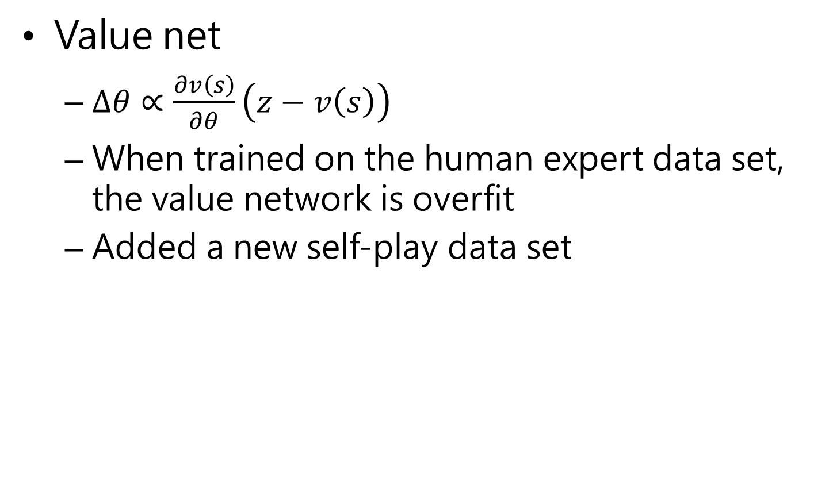
Training Value Networks
Value net
$∆θ∝\frac{∂v\left(s\right)}{∂θ}\left(z−v\left(s\right)\right)$
When trained on the human expert data set, the value network is overfit
Added a new self-play data set

Slide 19
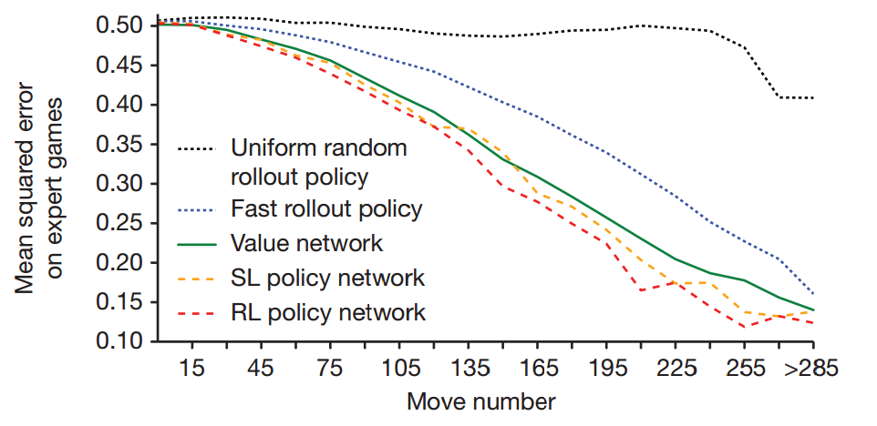
Game Result Prediction Accuracy

Slide 20
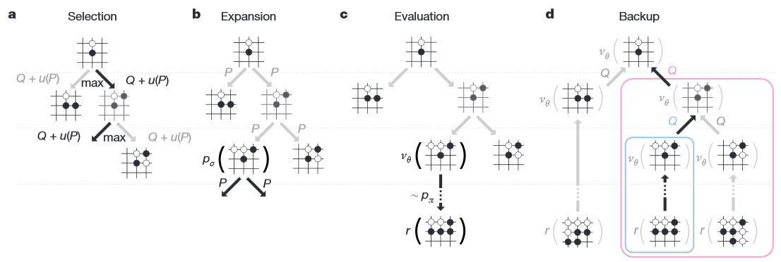
Test Phase

Slide 21
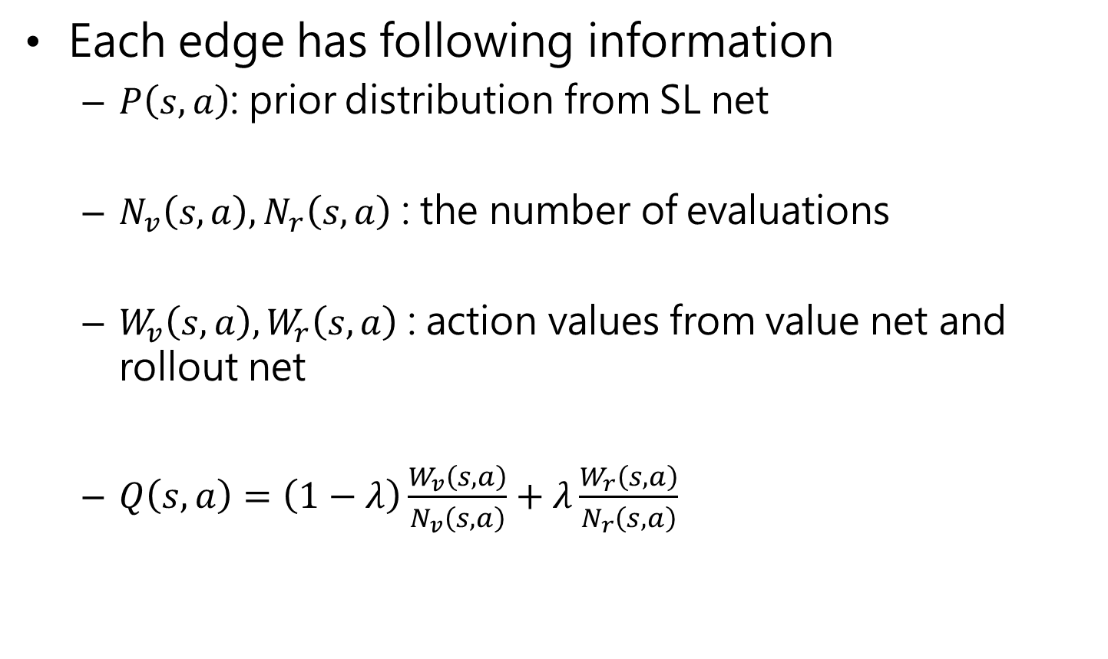
Test Phase
Each edge has following information
$P\left(s,a\right)$: prior distribution from SL net
$N_{v}\left(s,a\right),N_{r}\left(s,a\right)$ : the number of evaluations
$W_{v}\left(s,a\right),W_{r}\left(s,a\right)$ : action values from value net and rollout net
$Q\left(s,a\right)=\left(1−λ\right)\frac{W_{v}\left(s,a\right)}{N_{v}\left(s,a\right)}+λ\frac{W_{r}\left(s,a\right)}{N_{r}\left(s,a\right)}$

Slide 22
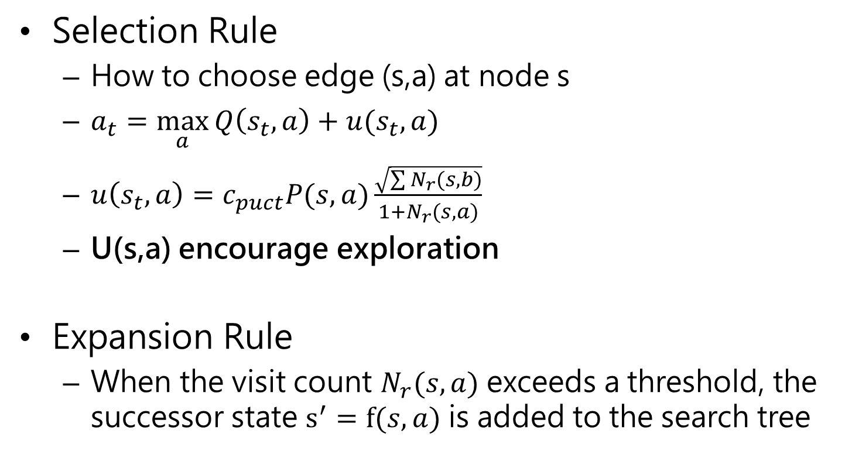
Test Phase
Selection Rule
How to choose edge (s,a) at node s
$a_{t}=\max_{a}{Q\left(s_{t},a\right)}+u(s_{t},a)$
$u\left(s_{t},a\right)=c_{puct}P(s,a)\frac{\sqrt{\sum{N_{r}(s,b)}}}{1+N_{r}(s,a)}$
U(s,a) encourage exploration
Expansion Rule
When the visit count $N_{r}(s,a)$ exceeds a threshold, the successor state $s^{′}=f(s,a)$ is added to the search tree

Slide 23
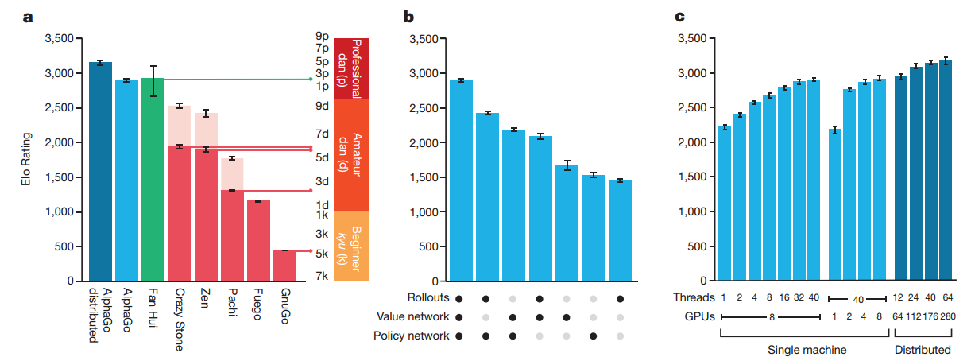
Result
Evaluation of playing strength of AlphaGo
Single-machine AlphaGo: 99.8%
With four handicap stones: 77%, 86% and 99% (vs CrazyStone, Zen and Pachi)
Distributed AlphaGo: 77% (vs Single-machine), 100% (vs Others)

Slide 24
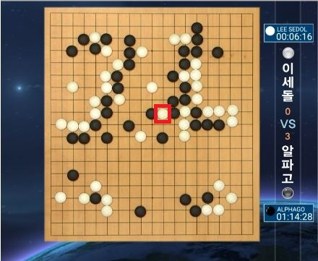
Result
Match score: AlphaGo 4 - Lee Sedol 1

Slide 25

Conclusion

